Slide 1

PROJECT OF FINANCIAL ACCOUNTING
PRESENTED By :
JAWERIA ASIF
JAVERIA HASSAN
HAMNA

Slide 2
ACCOUNTING PROBLEM
For the past several years, John Addams has operated a part-time business from his home. As of April 1, 2002, John decided to move rented quarters to operate the business, which was to be known as Addams & Family Inc., on a full time basis. Addams and Family entered into the following transaction during April:
April 4 The following assets were received from John Addams: cash, $10,000; accounts receivable, $1,500; supplies, $1,250; and office equipment, $7,500. There were no liabilities received.
April 4 Paid three months’ rent on a lease rental contract, $4,500.
April 4 Paid the premium on property and casualty insurance policies for the year, $1,800
April 6 Received cash from clients as an advance payment for services to be provided, $3,000

Slide 3
ACCOUNTING PROBLEM
April 7 Purchased additional office furniture on account from Morrilton Company, $1,800
April 8 Received cash from clients on account , $800
April 11 paid cash for newspaper advertisement, $120
April 12 Paid Morrilton Company $800 for debt incurred on April 7
April 15 Recorded services provided on account for the period April 4-15, $2,250
April 15 Paid part-time receptionist for two weeks’ salary, $400
April 15 Recorded cash from cash clients for fees earned April 4-15, $3,175
April 18 Paid cash for supplies, $750
April 22 Recorded services provided on account for April 18-22, $1,100
April 22 Recorded cash from cash clients for fees earned April 18-22, $1,850

Slide 4
ACCOUNTING PROBLEM
April 25 Received cash from clients on account, $1,600
April 27 Paid part-time receptionists for two week’s salary, $400
April 28 Paid telephone bill for April, $130
April 29 Paid electric bill for April, $200
April 29 Recorded cash from cash clients for fees earned April 25-29, $2,050
April 29 Recorded services provided on account for April 25-29, $1,000
April 29 John received $4,500 from the company as his salary

Slide 5
ADAMS AND FAMILY INC GENERAL JOURNAL FOR THE MONTH OF APRIL 2002
Date | Particular’s | Debit | Credit
4/4 | Cash | 10,000
 | Account Receivables | 1,500
 | Supplies | 1,250
 | Office Equipment’s | 7,500
 | Contributed Capital |  | 20,250
4/4 | Prepaid Rent | 4,500
 | Cash |  | 4,500
4/4 | Prepaid Insurance | 1,800
 | Cash |  | 1,800

Slide 6
ADAMS AND FAMILY INC GENERAL JOURNAL FOR THE MONTH OF APRIL 2002
4/6 | Cash | 3,000
 | Unearned Revenue |  | 3,000
4/7 | Office Equipment | 1,800
 | Accounts Payable |  | 1,800
4/8 | Cash | 800
 | Account Receivable |  | 800
4/11 | Advertising Expense | 120
 | Cash |  | 120

Slide 7
ADAMS AND FAMILY INC GENERAL JOURNAL FOR THE MONTH OF APRIL 2002
4/12 | Accounts Payable | 800
 | Cash |  | 800
4/15 | Accounts receivable | 2,250
 | Service revenue |  | 2,250
4/15 | Salaries Expense | 400
 | Cash |  | 400
4/15 | Cash | 3,175
 | Service Revenue |  | 3,175

Slide 8
ADAMS AND FAMILY INC GENERAL JOURNAL FOR THE MONTH OF APRIL 2002
4/18 | Supplies | 750
 | Cash |  | 750
4/22 | Accounts receivable | 1,100
 | Service Revenue |  | 1,100
4/22 | Cash | 1,850
 | Service Revenue |  | 1,850
4/25 | Cash | 1,600
 | Accounts Receivable |  | 1,600

Slide 9
ADAMS AND FAMILY INC GENERAL JOURNAL FOR THE MONTH OF APRIL 2002
4/27 | Salaries Expense | 400
 | Cash |  | 400
4/28 | Telephone Expense | 130
 | Cash |  | 130
4/29 | Utilities Expense | 200
 | Cash |  | 200
4/29 | Cash | 2,050
 | Service Revenue |  | 2,050

Slide 10
ADAMS AND FAMILY INC GENERAL JOURNAL FOR THE MONTH OF APRIL 2002
4/29 | Accounts receivable | 1,000
 | Service Revenue |  | 1,000
4/29 | Salaries Expense | 4,500
 | Cash |  | 4,500

Slide 11
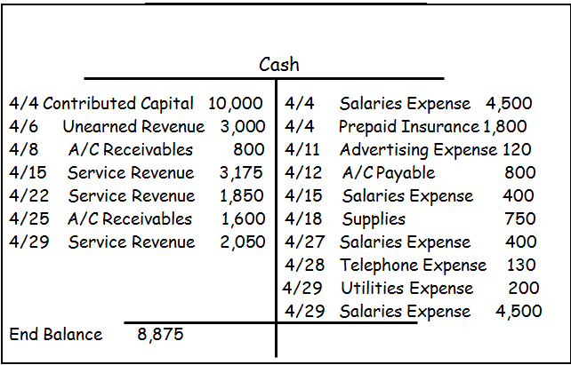
ADAMS AND FAMILY INC GENERAL LEDGERS FOR THE MONTH OF APRIL 2002

Slide 12
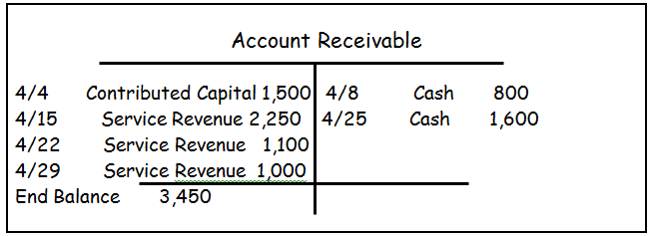
ADAMS AND FAMILY INC GENERAL LEDGERS FOR THE MONTH OF APRIL 2002

Slide 13
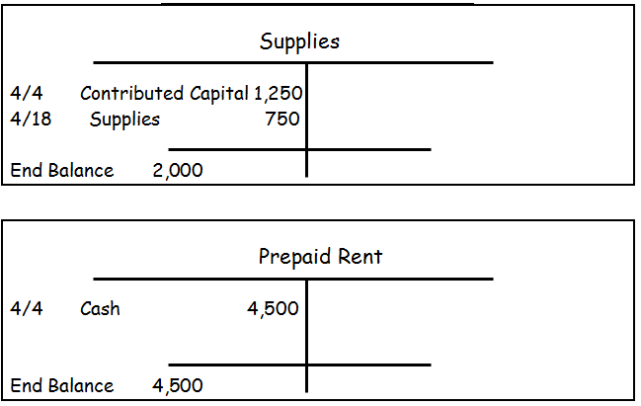
ADAMS AND FAMILY INC GENERAL LEDGERS FOR THE MONTH OF APRIL 2002

Slide 14
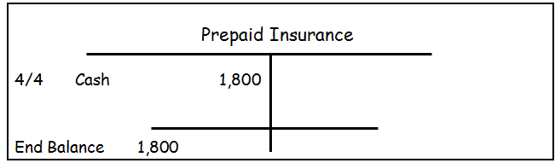
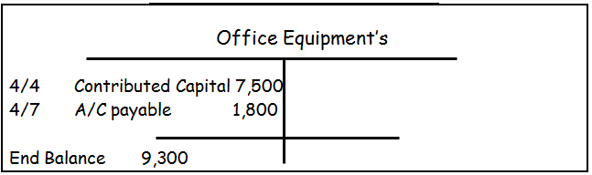
ADAMS AND FAMILY INC GENERAL LEDGERS FOR THE MONTH OF APRIL 2002

Slide 15
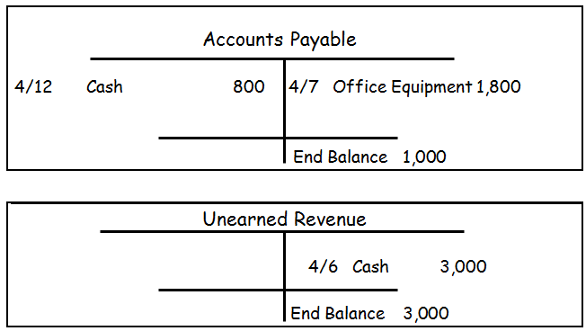
ADAMS AND FAMILY INC GENERAL LEDGERS FOR THE MONTH OF APRIL 2002

Slide 16
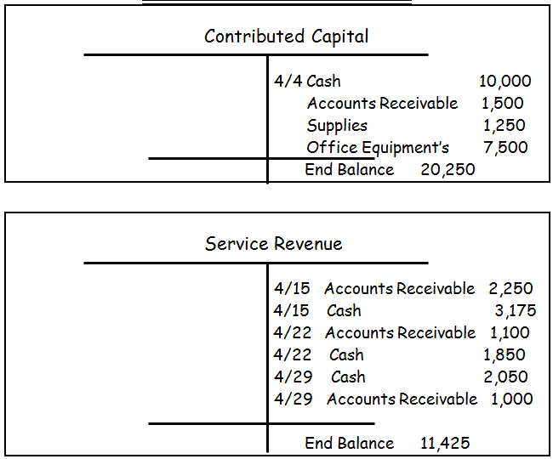
ADAMS AND FAMILY INC GENERAL LEDGERS FOR THE MONTH OF APRIL 2002

Slide 17
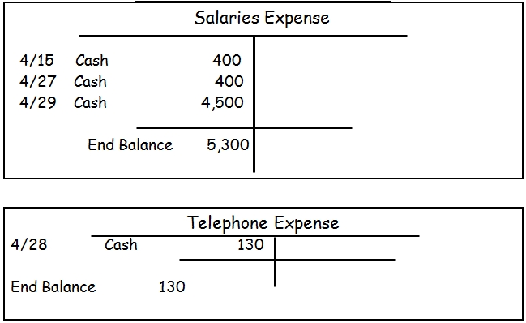
ADAMS AND FAMILY INC GENERAL LEDGERS FOR THE MONTH OF APRIL 2002

Slide 18
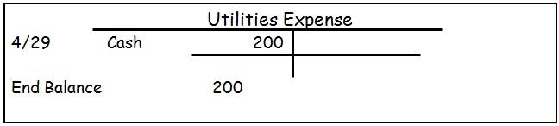

ADAMS AND FAMILY INC GENERAL LEDGERS FOR THE MONTH OF APRIL 2002

Slide 19
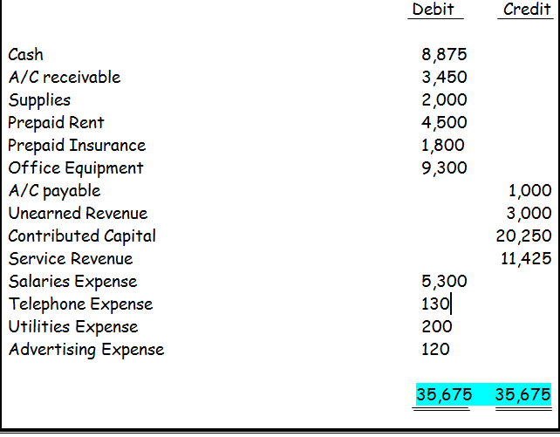
ADAMS AND FAMILY INC UN-ADJUSTED TRIAL BALANCE FOR THE MONTH OF APRIL 30, 2002

Slide 20
ADAMS AND FAMILY INC ADJUSTING GENERAL ENTRIES FOR THE MONTH OF APRIL 2002
Date | Particular’s | Debit | Credit
4/30 | Insurance Expense | 150
(a) | Prepaid Insurance |  | 150
4/30 | Supplies Expense | 980
(b) | Supplies |  | 980
4/30 | Depreciation Expense | 500
(c) | Accumulated Depreciation |  | 500
4/30 | Salaries Expense | 20
(d) | Salaries Payable |  | 20

Slide 21
ADAMS AND FAMILY INC ADJUSTING GENERAL ENTRIES FOR THE MONTH OF APRIL 2002
Date | Particular’s | Debit | Credit
4/30 | Rent Expense | 1,500
(e) | Prepaid Rent |  | 1,500
4/30 | Unearned Revenue | 2,000
(f) | Service Revenue |  | 2,000

Slide 22
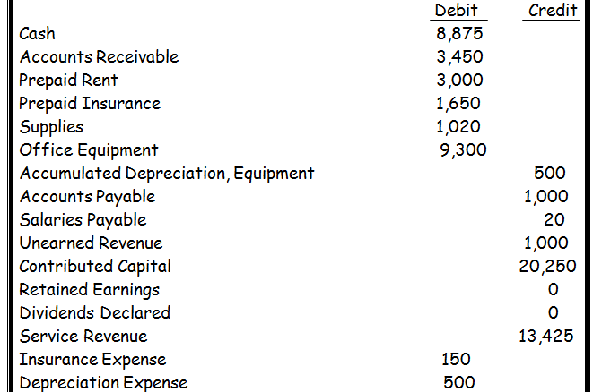
ADAMS AND FAMILY INC ADJUSTED TRIAL BALANCE FOR THE MONTH ENDED APRIL 30th, 2002

Slide 23
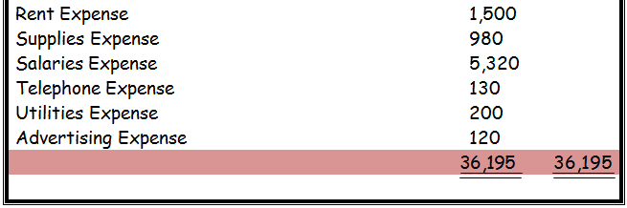
ADAMS AND FAMILY INC ADJUSTED TRIAL BALANCE FOR THE MONTH ENDED APRIL 30th, 2002

Slide 24
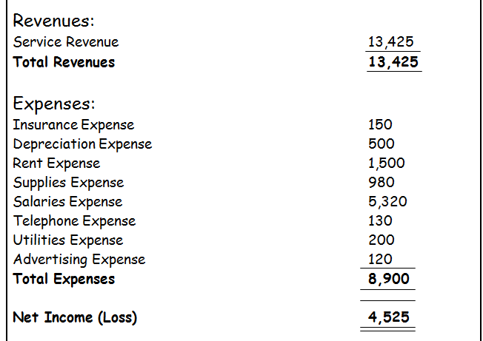
ADAMS AND FAMILY INC INCOME STATEMENT FOR THE MONTH OF APRIL, 30, 2002

Slide 25
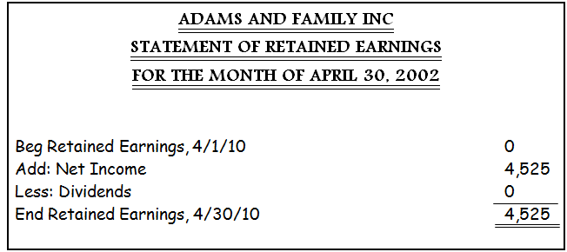

Slide 26
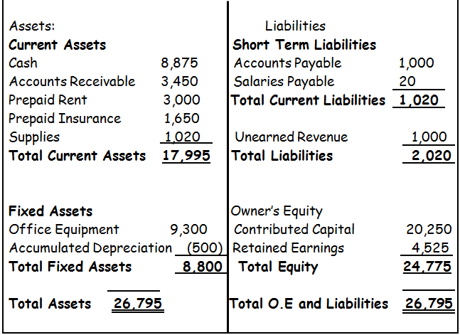
ADAMS AND FAMILY INC BALANCE SHEET FOR THE MONTH OF APRIL 30, 2002

Slide 27
ADAMS AND FAMILY INC CLOSING GENERAL ENTRIES FOR THE MONTH OF APRIL 2002
Date | Particular’s | Debit | Credit
4/30 | Service Revenue | 13,425
CJE#01 | Income summary Account |  | 13,425
 | (To record service revenue in income summary account)
4/30 | Income summary account | 8900
CJE#02 | Insurance Expense |  | 150
 | Depreciation Expense |  | 500
 | Rent Expense |  | 1,500
 | Supplies Expense |  | 980
 | Salaries Expense |  | 5,320

Slide 28
ADAMS AND FAMILY INC CLOSING GENERAL ENTRIES FOR THE MONTH OF APRIL 2002
 | Telephone Expense |  | 130
 | Utilities Expense |  | 200
 | Advertising Expense |  | 120
 | (To close Expense in income summary account)
4/30 | Income summary Account | 4,525
CJE#03 | Retained Earnings |  | 4,525
 | (To close retained earnings in income summary account )

Slide 29
